Slide 1
MLP Model for Predicting the Air Quality
AJAY KUMAR PARI
W10127743

Slide 2
Contents
Background
Introduction
Literature Survey
Problem Description
Experimental Evaluations
Summary
References
Key Elements
Methodology

Slide 3
Background
In order to predict the concentration of PM2.5 or other attributes, previously, deterministic and statistical methods were mainly used in air quality prediction.
The deterministic method is mainly based on the physical and chemical models of the atmosphere.
The statistical mathematical methods to establish the migration or diffusion model of the atmospheric pollution concentration, and then simulating the dynamic change of the atmospheric pollutant concentration .
However, these models require very rich information data, which is difficult to obtain in practice, and empirical estimation alone will have a greater impact on performance.
The study states that linear assumptions contained in these traditional statistical methods do not conform to the nonlinear characteristics of atmospheric concentration in reality.

Slide 4
Introduction
Air pollution is a serious environmental problem that has attracted increasing attention worldwide [1].
Among air pollution, particulate matter (PM) with diameters less than 2.5 microns, or PM2.5, has gained a lot of attention recently, partly because of its significant impact on our respiratory systems.
Performing statical approaches for modelling to understand the model accuracy.
In our methodology, a Multi-Layer Perceptron (MLP) scheme is used to predict the air quality and the performance metric of R-square score and Mean absolute error is to be observed.

Slide 5
Literature Survey
Athanasiadis et al. [2] used just a fuzzy lattice neurocomputing (FLN) model in their research to predict the pollution levels based upon O3 levels classified as low, moderate, and high levels of pollutants such as Sulphur dioxide, NO, and Nitrogen oxide that used FLN model. [3,4].
Hoek et al. [5] used regression methods to reach the conclusion that yearly mean PM2.5 concentrations could be predicted.
Kunwar et.al,[6] used principal components analysis (PCA) approach of an ensemble learning model used to integrate air pollution levels and predict the results of the Air Quality.
Based on previous day air pollution data, Corani [7] projected hourly O3 and PM10 concentrations using a neural network technique.

Slide 6
Problem Description
Multi Layer Perceptron Neural Networks has been shown to be capable of learning long time dependencies.
In time series data, has non linear characteristics.
Therefore, our focuses to predict the time series of air pollutants using MLP networks to improve the PM2.5 concentration prediction.

Slide 7
Technical Route
Import Dataset
Exploratory Data Analysis
Feature Scaling
Train Test Split
MLP
Performance Metric

Slide 8
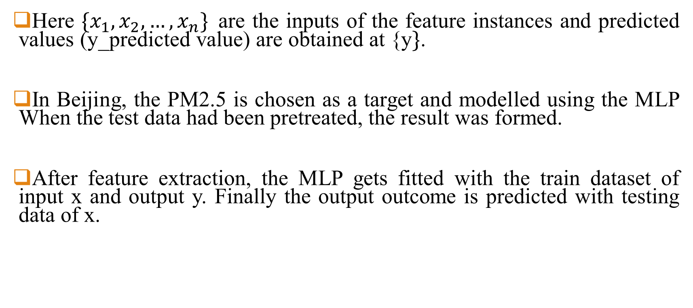
Methodology
Here ${\{x}_{1},x_{2},…,x_{n}\}$are the inputs of the feature instances and predicted values (y_predicted value) are obtained at {y$\}$.
In Beijing, the PM2.5 is chosen as a target and modelled using the MLP When the test data had been pretreated, the result was formed.
After feature extraction, the MLP gets fitted with the train dataset of input x and output y. Finally the output outcome is predicted with testing data of x.

Slide 9
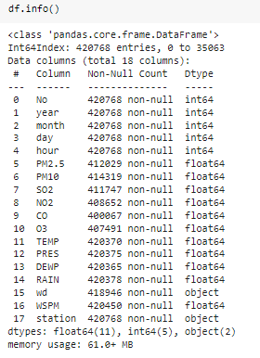
Dataset Description
Features | Description
year | year of data in this row
month: | month of data in this row
day: | day of data in this row
hour: | hour of data in this row
PM2.5: | PM2.5 concentration (ug/m^3)
PM10: | PM10 concentration (ug/m^3)
SO2: | SO2 concentration (ug/m^3)
NO2: | NO2 concentration (ug/m^3)
CO: | CO concentration (ug/m^3)
O3: | O3 concentration (ug/m^3)
TEMP: | temperature (degree Celsius)
PRES: | pressure (hPa)
DEWP: | dew point temperature (degree Celsius)
RAIN: | precipitation (mm)
wd: | wind direction
WSPM: | wind speed (m/s)
station: | name of the air-quality monitoring site
The following air quality dataset is collected from the Beijing air quality dataset from the University of California, Irvine, which contains meteorological data of pollution. The dataset instances are 4,20,768 and 11 Features and the memory usage was 61.0+ MB Attributes are:
Dataset : https://archive.ics.uci.edu/ml/datasets/Beijing+Multi-Site+Air-Quality+Data

Slide 10
Multi Layer Perceptron
A multilayer perceptron is a neural network connecting multiple layers in a directed graph, which means that the signal path through the nodes only goes one way.
Each node, apart from the input nodes, has a nonlinear activation function. An MLP uses backpropagation as a supervised learning technique.
Since there are multiple layers of neurons, MLP is a supervised machine learning technique.
MLP is widely used for solving problems that require supervised learning as well as research into computational neuroscience and parallel distributed processing. Applications include speech recognition, image recognition and machine translation.

Slide 11
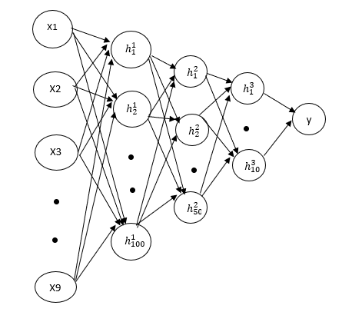
MLP Structure

Slide 12
Methodology Procedure
The procedure to impute the data and carry the predictions along with forecasting
1. Exploratory Data Analysis (EDA)
2. Data Pre-processing
3. Feature Selection
3. MLP Modelling

Slide 13
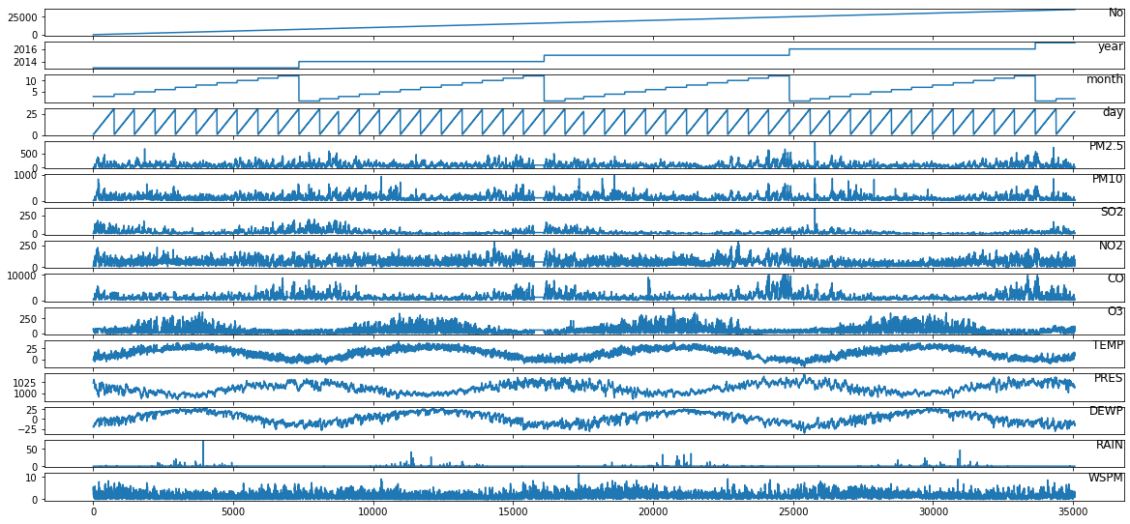
EDA Analysis
Exploratory Data Analysis refers to the critical process of performing initial investigations on data so as to discover patterns to spot anomalies, to test hypothesis and to check assumptions with the help of summary statistics and graphical representations.
Fig. 8. EDA analysis on Every Feature with Total Instances

Slide 14
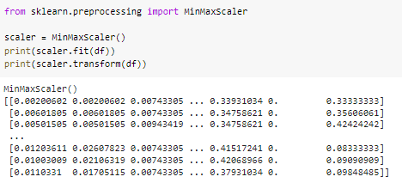
Data Pre-Processing
In data pre-process, Scaling is required to rescale the data and it’s used when we want features to be compared on the same scale for our algorithm. And, when all features are in the same scale, it also helps algorithms to understand the relative relationship better.
In our work, MinMax Scaler is used, where the scaler scales all the data features in the range [0, 1] or else in the range [-1, 1]
.

Slide 15
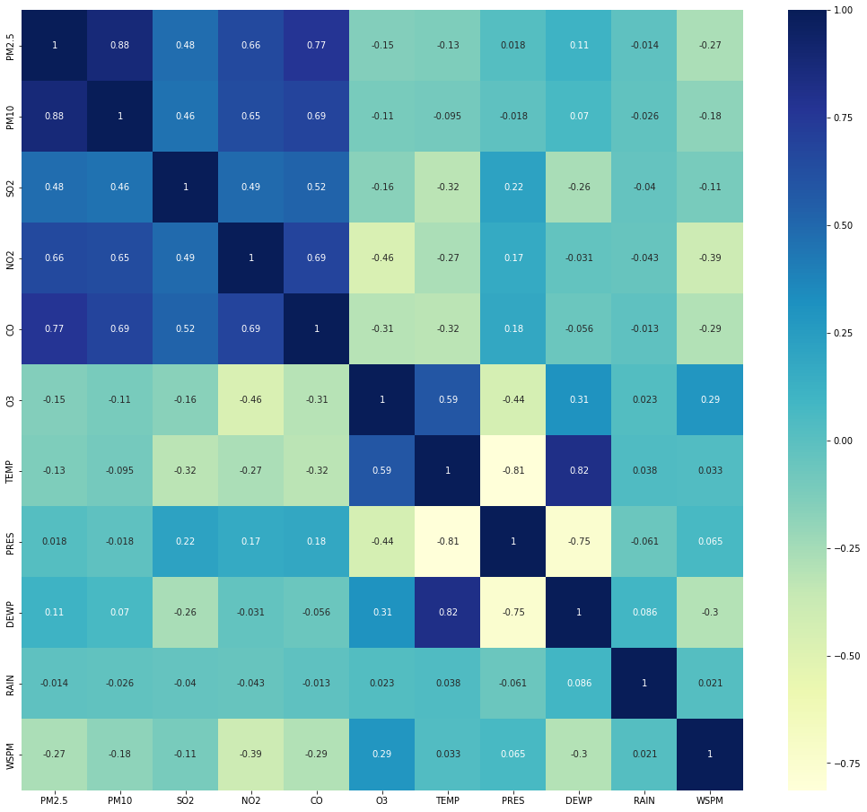
Feature Importance
The feature importance is observed in the statistical model i.e., Pearson Correlation Heat Map. From the correlation, the features are selected.
From the figure, we can observe that PM2.5, PM10, SO2, NO2, CO are the correlated features with each other.

Slide 16
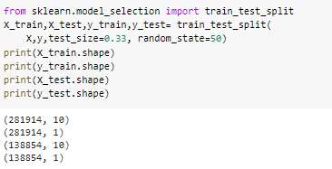
Train-test Size
After Feature importance, the training and testing size is importance to be given.
The train-test split procedure is used to estimate the performance of machine learning algorithms when they are used to make predictions on data not used to train the model.
In our proposed model, 67% is given for training and rest 33% is given for testing.

Slide 17
Model Trained Summary
The MLP model training was completed using the training set (4,20,768, 11) all the primary design variables in this work are input size, units trained
The MLP model has an input size of 11 features and the three hidden layers are used with the size of 100, 50, 10.
The Relu is used as an activation function for used for MLP and adam optimization is used for compile.
#Initializing the MLPRegressor
regr = MLPRegressor(hidden_layer_sizes=(100,50,10), max_iter=10,
activation = 'relu',solver='adam',random_state=1)

Slide 18



Performance Metrics
Since our research problem is a regression based problem, hence metric used to calculate the are errors. Hence R2 Score and Mean Absolute error.
R2 Score: The definition of R-squared is fairly straight-forward; it is the percentage of the response variable variation that is explained by a linear model.
Mean Absolute Error (MAE): MAE (Mean absolute error) represents the difference between the original and predicted values extracted by averaged the absolute difference over the data set.

Slide 19
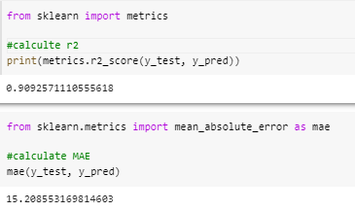
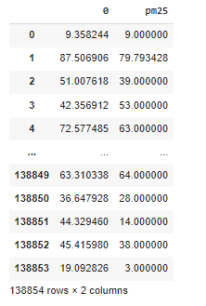
Results
R2 Score is 0.9
MAE score is 15.20
Predicted (0) vs PM25 (Actual)

Slide 20
Summary
According to the Proposed Methodology, a novel paradigm is used to predict PM2.5 levels in the atmosphere.
The preliminary analysis such as Exploratory data analysis, Scaling, Feature importance, is also performed.
The air quality predicting is carried out on the MLP which is a supervised Machine learning algorithm and the metric scores for R2 is 0.9 and MAE is 15.20

Slide 21
References
[1]International Agency for Research on Cancer, Carcinogen List, http://samr.cfda.gov.cn/WS01/CL1991/215896.html, 2017.
[2]Athanasiadis, I.N.; Kaburlasos, V.G.; Mitkas, P.A.; Petridis, V. Applying machine learning techniques on air quality data for real-time decision support. In Proceedings of the First international NAISO symposium on information technologies in environmental engineering (ITEE’2003), Gdansk, Poland, 24–27 June 2003.
[3] Famoso, F.; Wilson, J.; Monforte, P.; Lanzafame, R.; Brusca, S.; Lulla, V. Measurement and modeling of ground-level ozone concentration in Catania, Italy using biophysical remote sensing and GIS. Int. J. Appl. Eng. Res. 2017, 12, 10551–10562.
[4] Hoek, G.; Beelen, R.; de Hoogh, K.; Vienneau, D.; Gulliver, J.; Fischer, P.; Briggs, D. A review of land-use regression models to assess spatial variation of outdoor air pollution. Atmos. Environ. 2008, 42, 7561–7578.
[5] Lee, J.-H.; Wu, C.-F.; Hoek, G.; De Hoogh, K.; Beelen, R.; Brunekreef, B.; Chan, C.-C. Land use regression models for estimating individual NOx and NO2 exposures in a metropolis with a high density of traffic roads and population. Sci. Total. Environ. 2014, 472, 1163–1171
[6] Singh, K.P.; Gupta, S.; Rai, P. Identifying pollution sources and predicting urban air quality using ensemble learning methods. Atmos. Environ. 2013, 80, 426–437.
[7]Corani, G. Air quality prediction in Milan: feed-forward neural networks, pruned neural networks and lazy learning. Ecol. Model. 2005, 185, 513–529.

